Slide 1

Gender Differences.km,nbv in Undergraduate Engineelkjhgfring Applicants: A Text Mining Approach
Shivangi Chopra, Hannah Gautreau, Abeer Khan,
Melica Mirsafian, Lukasz Golab

Slide 2
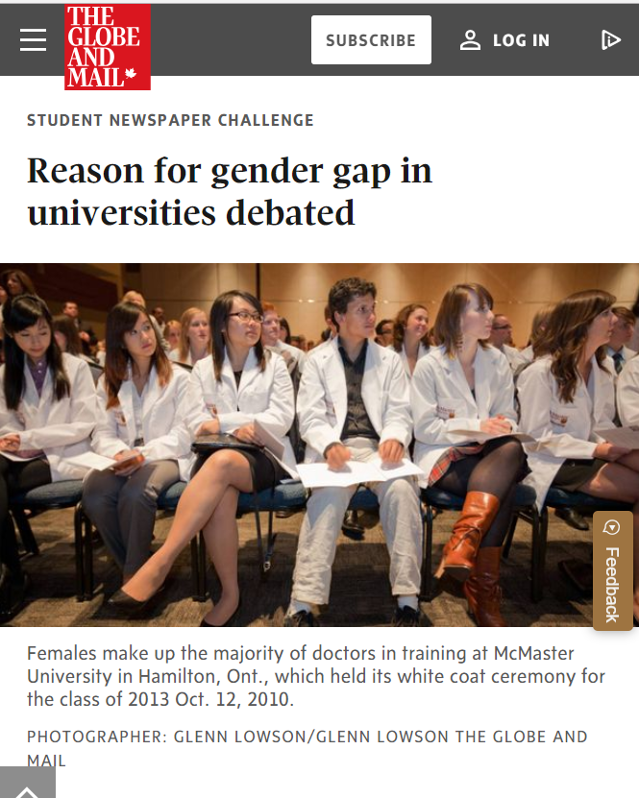
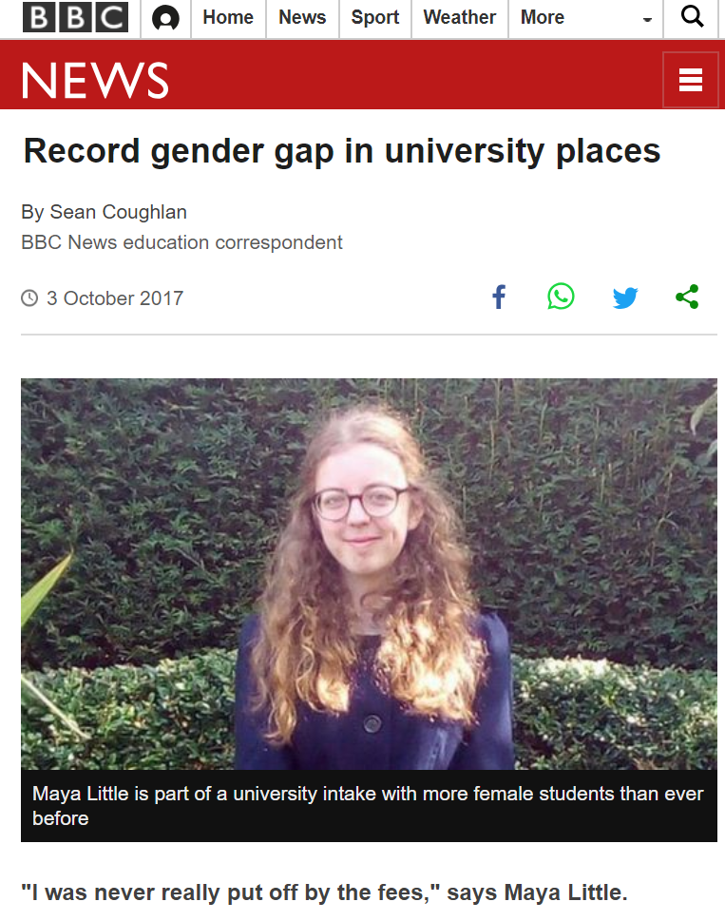
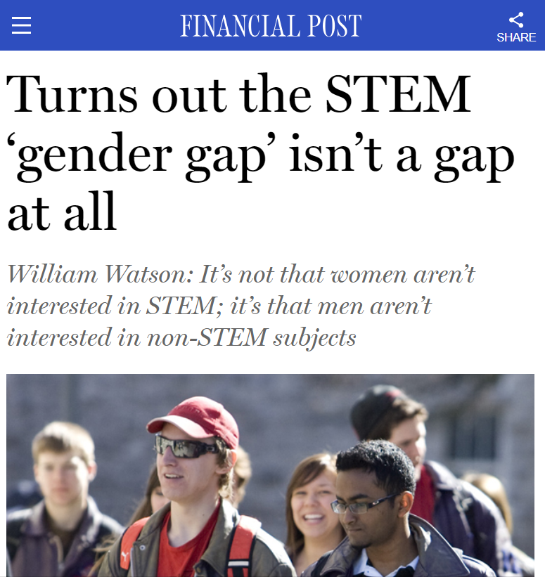
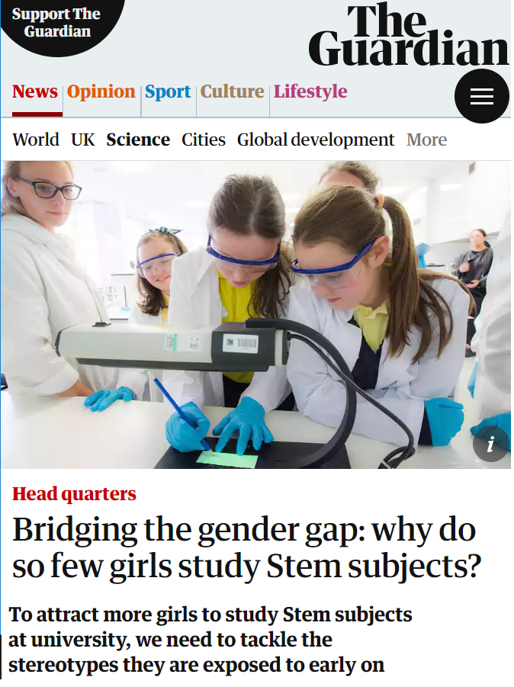
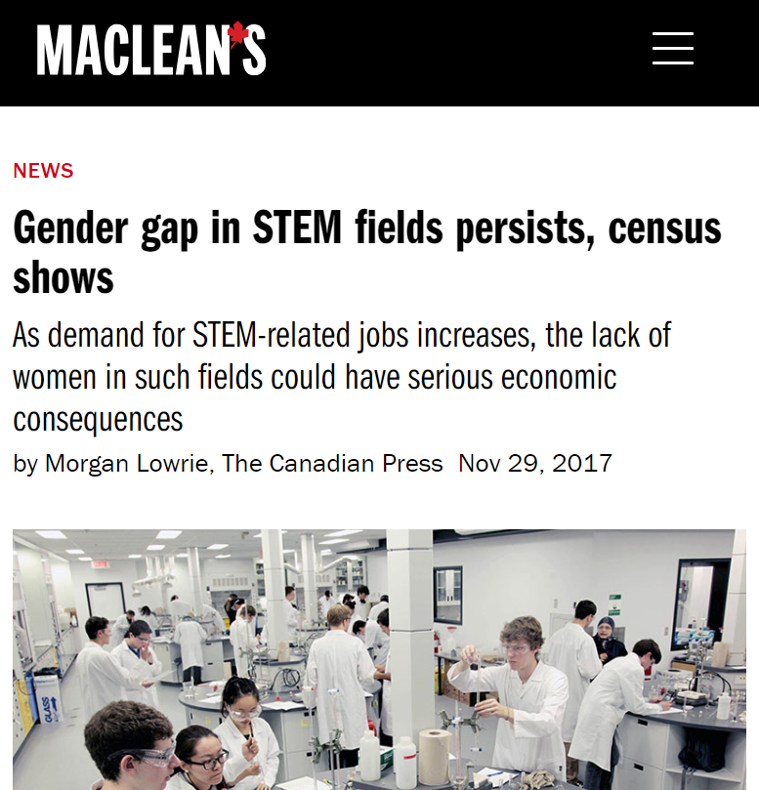

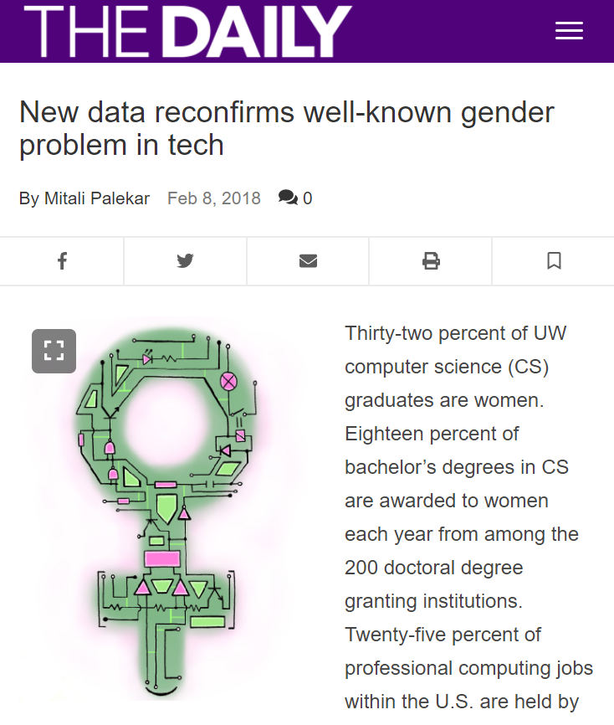
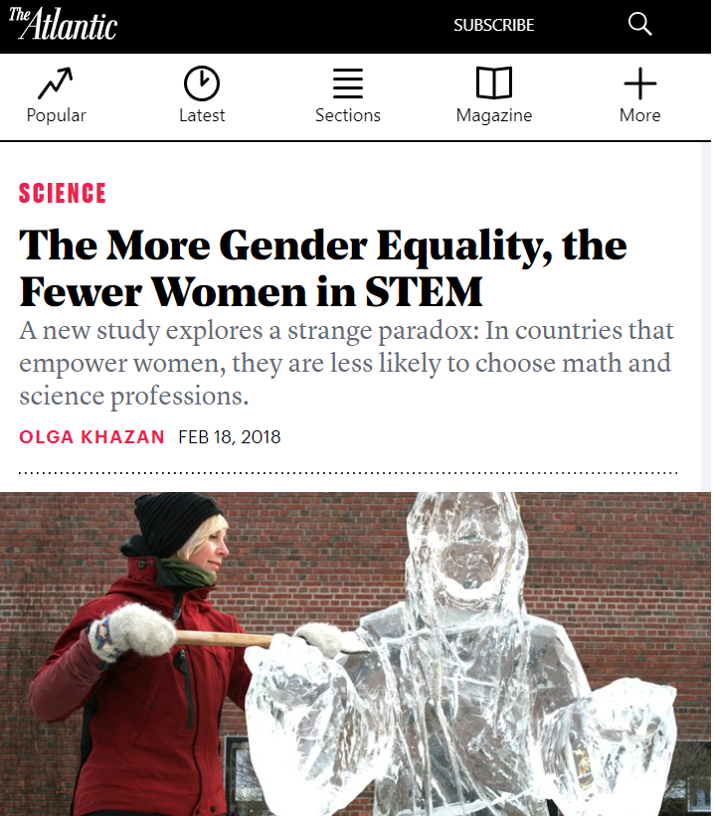
Gender Gap in STEM

Slide 3
Related Work
Women are uninterested, not unqualified
Influenced by family members

Slide 4
Our Work
Access to unique dataset
Big Data analysis approach to gaining insights into gender gap in engineering
Better support for results

Slide 5
Do men and women have different reasons
for pursuing an engineering degree?

Slide 6
Dataset
Undergraduate applications to the faculty of engineering
Both admitted and non-admitted students
Free text answers to questions regarding:
Reasons for interest in engineering
Reading interests
Extracurricular activities
Jobs held through high school
Programming experience (mandatory for software engineering)
Additional information
Notes:
Engineering Interests: Explain why you are interested in engineering and the specific program to which you applied
Reading Interests: Discuss a book or an article you enjoyed or that has had an impact on you (preferably something that was not part of a course at school)
Extracurricular Activities: List any extracurricular activities or areas of significant interest
Jobs held through high school: List any jobs you held through high school
Programming Experience: List any programming experience you have
Additional Information: Tell us anything else about yourself that you would like us to know when we review your application

Slide 7
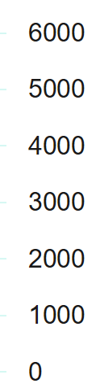
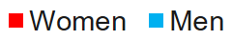
Dataset
21%
Other
Engineering
Programs
Software Engineering
79%
14%
86%
Biomedical &
Environmental
Engineering
52%
Total = 27,087
48%
Total = 3,635
Total = 3,036
# Applicants
# Applicants
62%
48%
72%
47%
# Applicants
83%
84%
88%
86%
62%
64%
75%
76%
88%

Slide 8
Key Results
Depth of experience in men
Breadth of experience in women
Family influence
No difference in technical interests

Slide 9
Our Analyses
Syntactic analysis
Semantic analysis
3 groups of programs
Biomedical & Environmental engineering
Software engineering
Other programs
Notes:
Syntactic: mere word usage count
Semantic: meaning of words to detect their REASONS, go further than just word count, group statements by their meaning to get a higher overall understanding of trends

Slide 10
Syntactic Analysis Methodology
Preprocessing
Stop word removal
Tokenization
Stemming
Document frequency on the 6 free text questions
Statistically significant differences
P-value < 0.05
Notes:
Document Frequency: a term in Information Retrieval that tells us what percentage of men/women used each word in the dictionary at least once?
Do I need to put on the screen what document frequency is?
All differences reported will be statistically significant differences with a P-value < 0.05
What was the statistical test used for this purpose? Z score for population proportions

Slide 11


Syntactic Analysis on Engineering Interests
Biomedical &
Environmental
“health”, “improve”, “love”, “research”
“mechanical”, “compute”
Software
“science”, “research”, “people”
“system”, “problem”, “game”, “goal”
Other Programs
“chemical”, “science”, “creative”, “study”, “love”
“mechanical”, “compute”, “robot”, “car”

Slide 12
Syntactic Analysis on Reading Interests
“love”
“novel”
“character”
“women”
“people”
“family”
“article”
“enjoy”
“compute”
“science”

Slide 13
Syntactic Analysis on Extracurricular Activities
Biomedical &
Environmental
“dance”, “art”,
“lead”
“robot”,
“coach”
Software
“art”, “council”,
“dance”, “lead”
“compute”
Other Programs
“dance”, “council”, “art”, “volunteer”, “lead”
“robot”,
“compute”
Notes:
Men: Technical + Sports
Women: Wider variety: dance, art, volunteer, leadership

Slide 14
Syntactic Analysis on Job Titles
“cashier”,
“teacher”,
“assist”
“referee”,
“labor”,
“technician”
Notes:
Explain what Document Frequency is → a term in Information Retrieval ...
Explain what TF-IDF is

Slide 15
Syntactic Analysis on Programming Experience
“mark”,
“attend”
“game”,
“develop”
Also, small difference in experience and number of known languages
Notes:
Manual inspection revealed that “mark” was related to getting a certain mark in a course, and “attend” was used to indicate attendance in a programming workshop or event
Also, extracting their mentions of specific programming languages and their experience in them, small difference was found. (probably no need to mention, but the differences were mostly below 5%)

Slide 16
Key Insights from Syntactic Analysis
Interest in technical activities in men
Broad range of interests in women

Slide 17
Semantic Analysis
Most popular topics
A semantic approach
Statistically significant differences between men and women?
P-value < 0.05
Notes:
Look into the meaning of students’ answers to why they were interested in engineering
All reported differences are statistically significant with a p-value of less than 0.05 → Z score for population proportions

Slide 18


Semantic Analysis
Why are you interested in Engineering
What inspired you to study Engineering?
Why do you want to study Engineering?
Why do you like Engineering?
…
9 Questions
Raw Text Response
Response to the question:
“Explain why you are interested in engineering and the specific program to which you applied”
Notes:
9 questions, they are all rephrasing of the same question :why interested in engineering (we called engineering interests, one of those 6 questions we mentioned in the application form)

Slide 19

Semantic Analysis
9 Questions
Question Answering
Open source QA API ¹
Raw Text Response
¹ https://github.com/allenai/bi-att-flow
Notes:
9 input questions, therefore up to 9 answers for each student (we take only unique answers)

Slide 20
Semantic Analysis
9 Questions
Question Answering
Raw Text Response
Relevant Sentences
Stop Word Removal

Slide 21

Semantic Analysis
…
…
‘s
Word2Vec Model²
“mother”
…
…
9 Questions
…
…
Question Answering
Sentence Vector Computation
…,
…,
…,
…
1.2, 0.5, 1.9, 0.8
…,
…,
…,
…
Raw Text Response
Relevant Sentences
Relevant Sentences
Average
Stop Word Removal
Sentence Vector
² https://code.google.com/archive/p/word2vec/
Notes:
Word Embeddings

Slide 22
Semantic Analysis
9 Questions
Question Answering
Sentence Vector Computation
Raw Text Response
Relevant Sentences
Relevant Sentences
Sentence Vectors
Stop Word Removal
Clustering of Sentence Vectors
K-means
K = 200 Clusters
Notes:
Choice of K will be explained after step 5

Slide 23
Semantic Analysis
Kid work day
Young age father
Visit construct site
Watch father work
…
9 Questions
Question Answering
Sentence Vector Computation
Cluster Representative Extraction
Raw Text Response
Readjust
K
Relevant Sentences
Relevant Sentences
Sentence Vectors
200
Clusters
Stop Word Removal
Clustering of Sentence Vectors
Notes:
how do I gracefully and concisely define TF-IDF here? :D
TF-IDF is a method to extract important information/words (or set of consecutive words) from text

Slide 24

Semantic Analysis
Choice of K in K-means
Cluster Representative Extraction
Kid work day
Apart tri together
Love thing apart
Countless hour spent
Use everi day
Play close attent
Decid high school
…
Kid work day
Young age father
Visit construct site
Watch father work
Older brother mechanic
Dad electr took
Work day dad
…
Readjust
K
200
Clusters
K = 50
K = 200
Clustering of Sentence Vectors

Slide 25
Semantic Analysis
9 Questions
Question Answering
Sentence Vector Computation
Cluster Representative Extraction
Raw Text Response
Readjust
K
Relevant Sentences
Relevant Sentences
Sentence Vectors
200
Representatives
200
Clusters
Stop Word Removal
Clustering of Sentence Vectors
Cluster Merging
Manual merging

Slide 26
Reasons for Interest in Engineering
Technical Interests
Love of Science
Extracurriculars
creat new technolog
water treatment plant
use dismantle toy
develop medic technolog
book watch video
robot competit team
particip extracurricular activ
improv people live
make world better
make contribut societi
pursu graduat studi
job opportun engine
futur career goal
leadership comic skill
profici skill mathemat
attend open house
talk student professor
follow footstep father
older brother mechanic
Prior Accomplishments
talk physic teacher
high school student
began young age
dream childhood dream
math physic chemistri
love math science
Contribution to Society
Professional Development
Family
Outreach
High School
Childhood Dream

Slide 27
Differences in Reasons
Love of Science
-
Biomedical &
Environmental
Software
Family
-
Contribution to Society
Outreach
Love of Science
Other Programs
Extracurriculars
Childhood Dream

Slide 28
Key Insights from Reasons
Technical Interests
2 Topics per person
Minimal difference in Biomedical & Environmental Engineering
Contribution to Society and Technical Interests inversely proportional
More Topics
Family Influence
Interest in Contributing to Society
Technical Depth
Extracurricular Activities
Childhood Dream

Slide 29
Implications
Technical Interests in both genders
Opportunities for focused outreach
Repaint the face of engineering

Slide 30
Conclusion
Syntactic and semantic analysis of text
Little technical difference
Depth of experience in men
Breadth of experience in women

Slide 31
Highlight the aspects of engineering that women find important
Notes:
Just like boys, some women are good at math and science, some are not,
But women should apply to engineering not just because they can but because they should want to
So we should highlight the aspects of engineering that women find important

Slide 32
Thank You

